Slide 1

Dynamic cover-based system for Unity Game AI Players
Student Name: Leo Groza
Student NUMBER: B00727232
Supervisor: Tendai Mhlanga

Slide 2

“Performance by default…”
In the past years the video game industry has established itself as a significant contributor in the global economy.
“Call of Duty” released in November 2011 has seen a revenue of $400 million in the first week
The industry has grown exponentially inventing itself and becoming dynamic.
The game industry has pioneered different type of technology in the development process:
molecular biology ;
military training;
virtual showrooms.
IEEE and Unity Game Engine.
Notes:
A high number of articles on IEEE related with Unity game engine

Slide 3
“Performance by default…”
Gaming is seen in the present day as a habit;
encourages logical development;
practical concept learning;
provides entertainment.
New games are released every year, quality and innovation is obligated to improve with every release.
Possibility achieved with Game Engines.
Every new challenge released leads to spending a large amount of time in front of the computer in an attempt to overcome a challenge.
Every new challenge release pushes to a hardware upgrade.
Notes:
Gamming become a job, tournaments are held with a substantial amount of cash prize.
It takes a large amount of time to create a game
This is where game engines come to life.

Slide 4
Game Engines
The game engine concept has been developed to minimise what is called common game methods such as:
Physics;
Programming;
AI;
Rendering process;
Development control.
Game engines have replaced the concept of reinventing the wheel.
Unity Game Engine;
Responsible for 45% of the world’s games.
Notes:
Allow the developer space and time to focus on features that can make its software unique.

Slide 5
Project Aims
Project Target:
Develop a unique cover-based feature for a game developed in Unity, “Patient Zero”.
Attempt to reduce the need for hardware upgrade with every new game release;
Project Aims:
Review the multithreading objective in relation to Unity Jobs System;
Create individual sequences of instructions for AI agent functionalities;
Develop AI dynamic cover at run-time, eliminating the pre-set position framework;
Improve the current implemented coordination framework, A* Pathfinder.

Slide 6

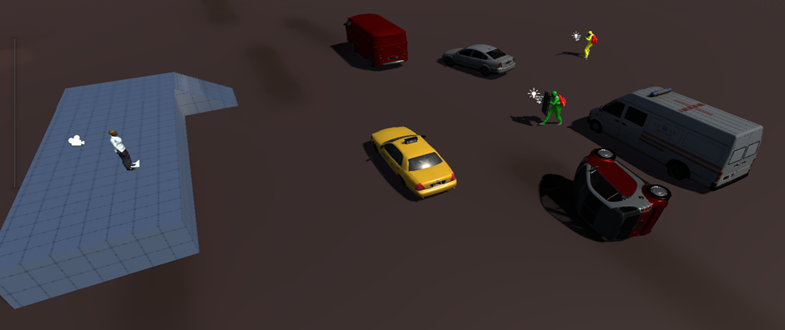
Development Background
Patient Zero, the project background, is a 3rd person shooter currently in development in Unity game engine.
A simple scene constructed with Unity assets extracted from Patient Zero is set as the development environment.
Unity 3D provides powerful integration tools and incorporates several components, such as game objects, intended for 2D and 3D game development

Slide 7

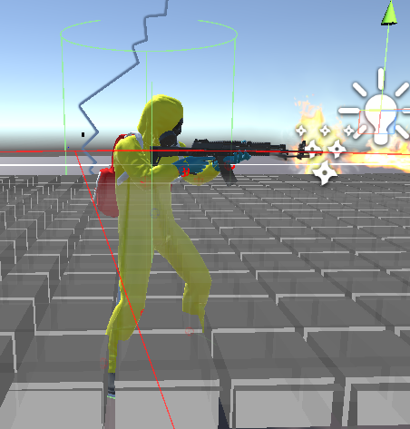
AI Profiling
The soldier AI game objects stands as the development base for the project.
The aims and objectives of the project are connected to the AI game object.
Must comply to a set of rules:
3D Game Object;
Animations;
Collider;
Rigidbody;
NavMesh Agent.

Slide 8
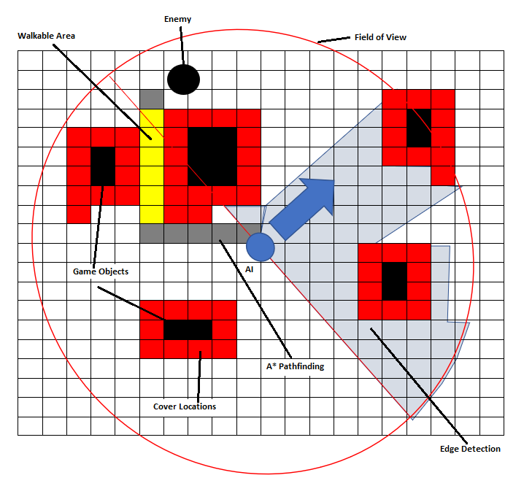
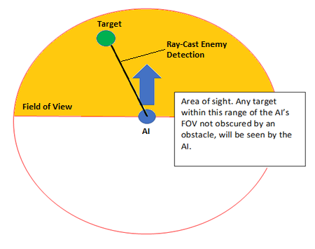
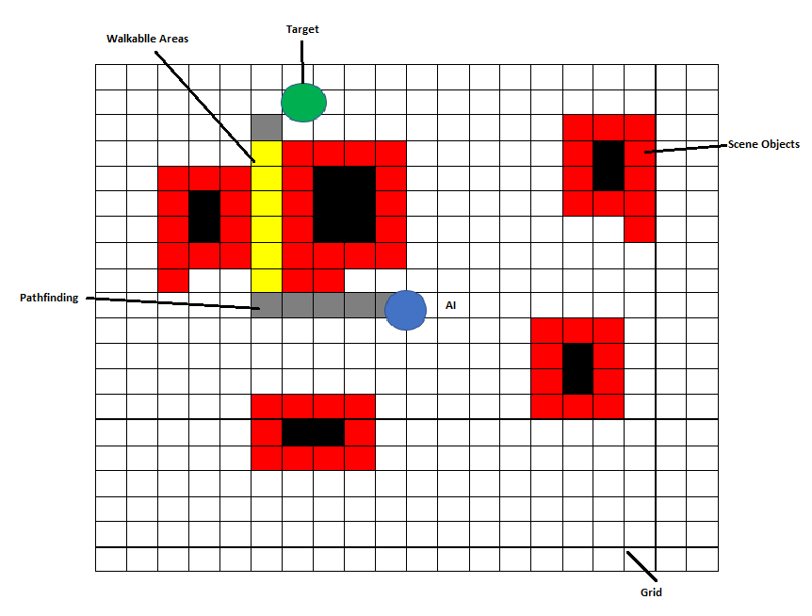
Common Scripts Attached to the AI Agent
Field of View – equivalent to a sight simulation procedure for the AI agent;
A* Pathfinding method – a computer algorithm designed to establish the shortest distance between two points;
Edge Detection – algorithm designed to uncover every obstacle in the game scene and establish available cover locations;

Slide 9
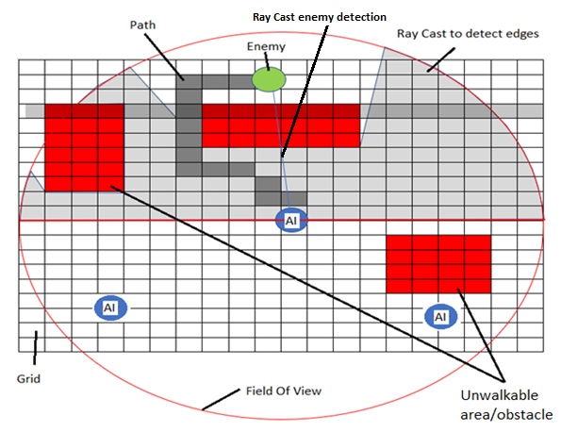
Overview of the complete AI functionality

Slide 10
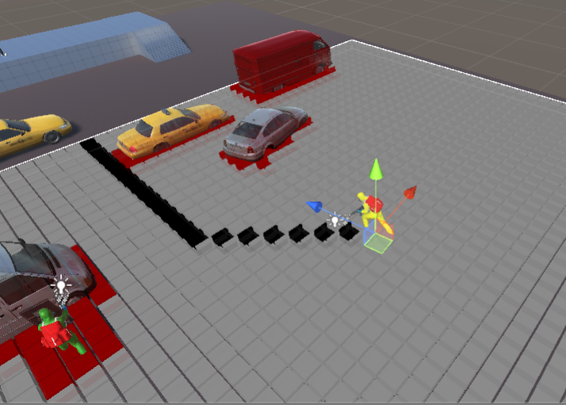
Overview of the complete AI functionality

Slide 11
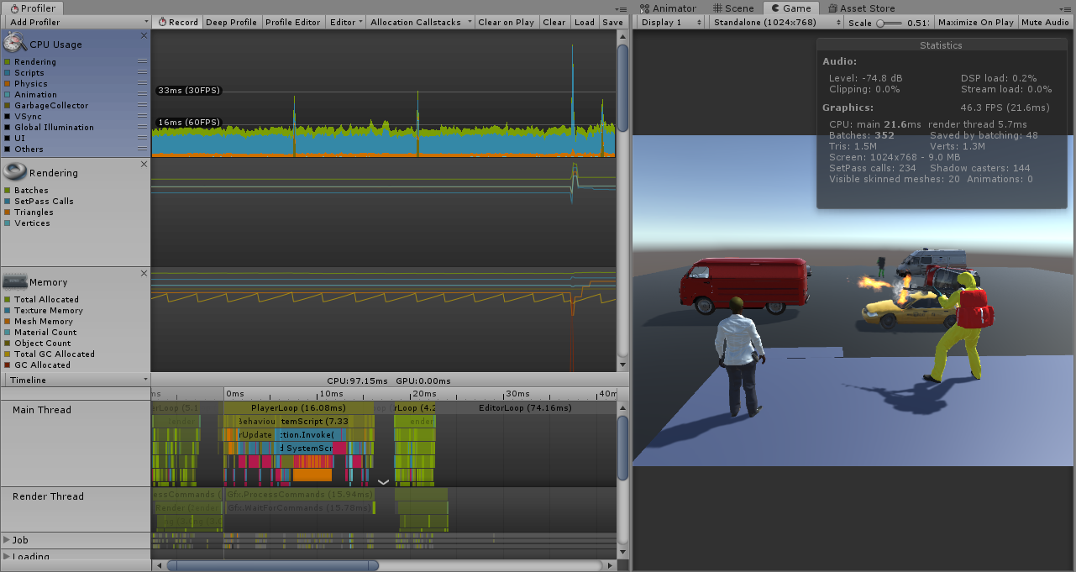
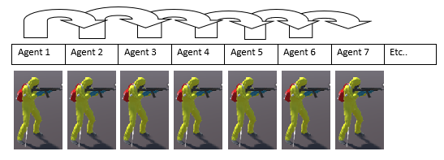
Unity Profiler
A powerful tool developed by Unity to provide insights about the functionality of different parts of the software.
The Unity profiler can measure the performance of the game at game play and provide information for performance drop.
The baseline performance for project development, for a game scene with one AI objects is approximately 46 FPS.
To reduce computations, every Update () method, has been removed from the scripts of the AI game objects.

Slide 12
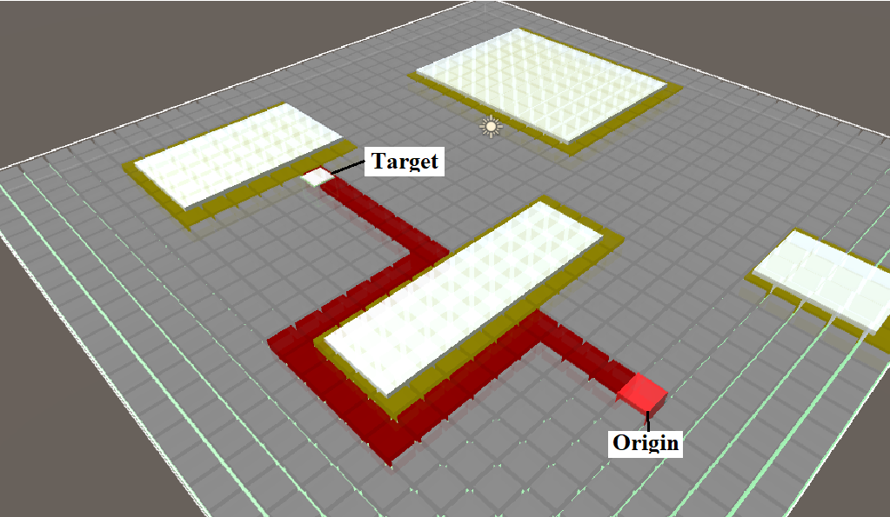
Efficient AI coordination frameworks
A* Pathfinding algorithm
AI game object discovers paths to the target using A* Pathfinder algorithm;
Calculates the shortest route towards the target in real-time, capable of dynamic game detection;
Pathfinding algorithms are developed on the base of net search algorithms, a node collection connected between links.
Every link in the net has a value which is the travel cost incurred if the algorithm passes through that link also known as a heuristic;
Based on a grid.

Slide 13
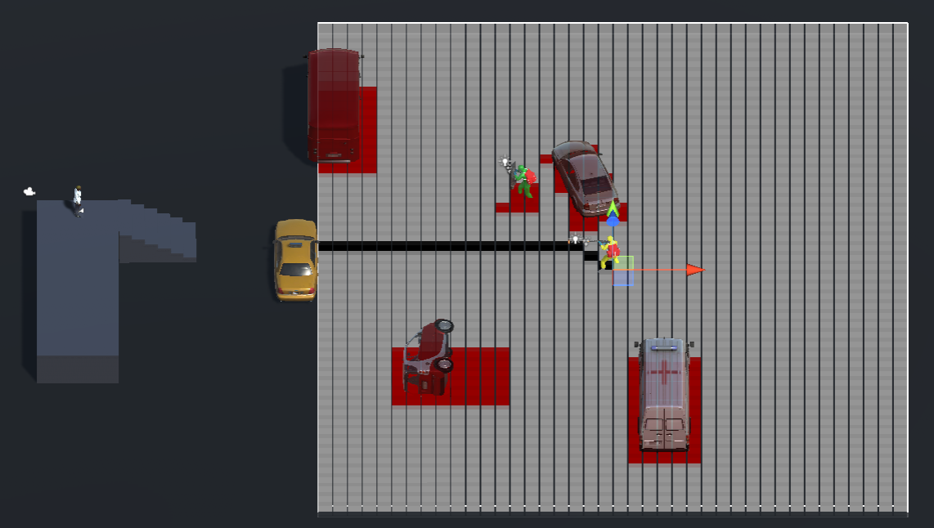
Efficient AI coordination frameworks
A* Pathfinding Shortfalls
Grid size – the grid size used in the project, in grid nodes is 50 x 50;
The ideal size would cover the whole scene.
Node size – size 1 unit nodes are used;
The ideal node size would be 0.5;
Cannot calculate a path if a game object stands at the edge of the grid blocking the path;
Pathfinding algorithm cannot be triggered if the target is not in the field of view of the AI;
Not suitable for multi-levelled scene;
Cannot detect objects thrown in the scene at run-time.

Slide 14
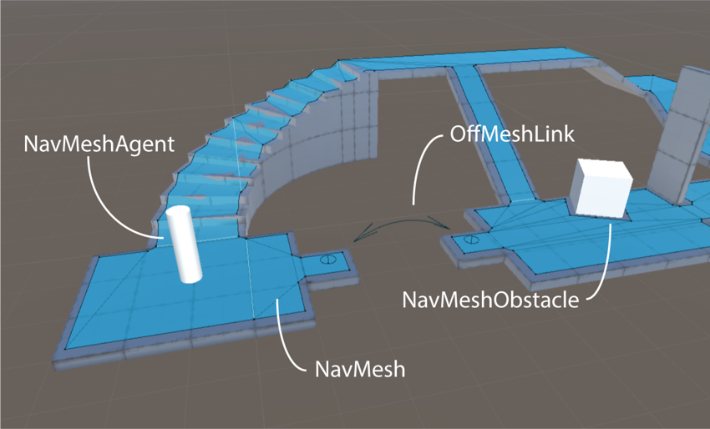
Efficient AI coordination frameworks
Unity NavMesh
Native to Unity, uses a navigation mesh determined by the geometry of the scene;
Structure:
NavMesh – describes the walkable surfaces in the scene;
NavMesh Agent – component that determines the movement of the character in the scene;
Off-Mesh Link – component designed to incorporate shortcuts;
NavMesh Obstacle – component designed to determine obstacles places in the game scene

Slide 15
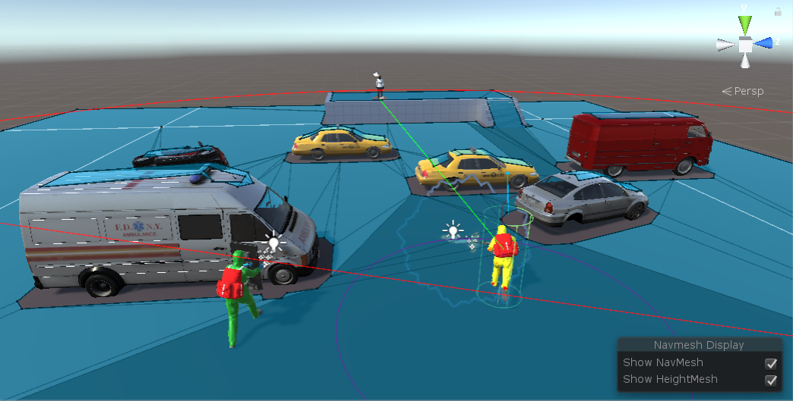
Efficient AI coordination frameworks
Unity NavMesh Advantages
Real time obstacle detection;
Covers the entire game scene;
Constructed on polygons;
Designed for multi-levelled scenes;
Not taxing the resources of the CPU;
The AI agent is automatically constrained to the surface of the NavMesh.

Slide 16
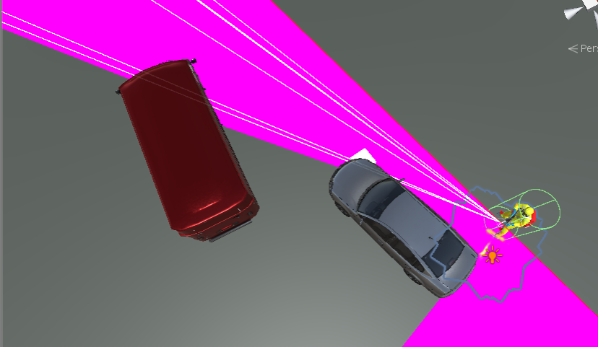
Dynamic cover-based system
Edge Detection
Triggered by the field of view of the AI;
AI agent instantiates 800 casts to determine objects and object edges;
Game objects assigned as cover locations are instantiated
Cover locations are limited by the field of view

Slide 17
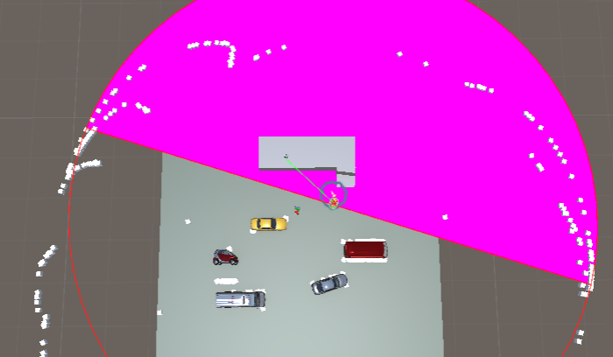
Dynamic cover-based system
Edge Detection Issues
Approximately 2000 game objects are instantiated;
Cover locations are set outside the game scene;
Multiple game objects are created in the same place one on top of another;
A number of cover locations are set in the direct view of the target.

Slide 18
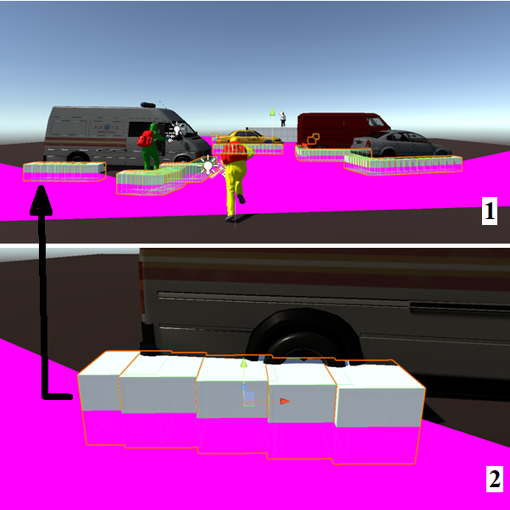
Dynamic cover-based system
Reducing the number of cover locations
A simple algorithm has been designed to reduce the number of cover locations;
Float to integer;
Total number of cover locations has been reduced to 32.

Slide 19
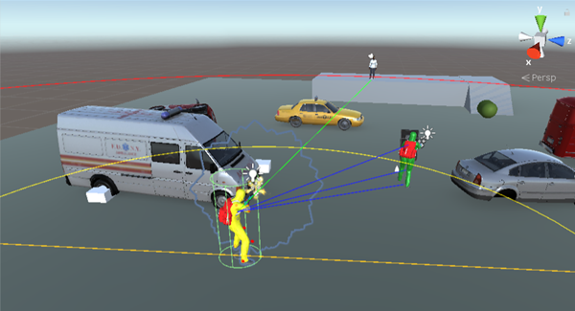
Dynamic cover-based system
Reducing the number of cover locations
A second field of view has been implemented for the AI agent to reduce even further the number of random instantiated cover locations;
Dummy cover position locations have been created to determine distance between instantiated objects;
Cover locations have been set in a dictionary providing a key for every object;
For every location a Boolean variable has been assigned to suit multiple AI agents in a scene– if false the cover location is free, else occupied.

Slide 21
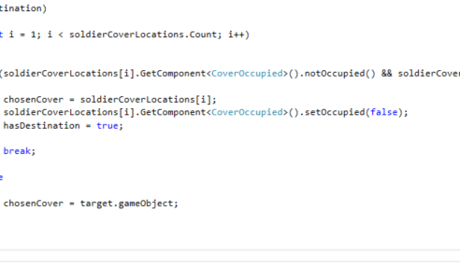
Dynamic cover-based system
Developing dynamic cover- based system
A primitive code has been developed to determine and move towards a cover location;
A fault in the code instantiated game objects in the center of the game world.
Dictionary.

Slide 22
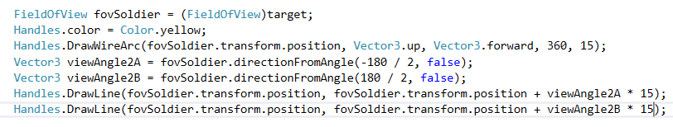
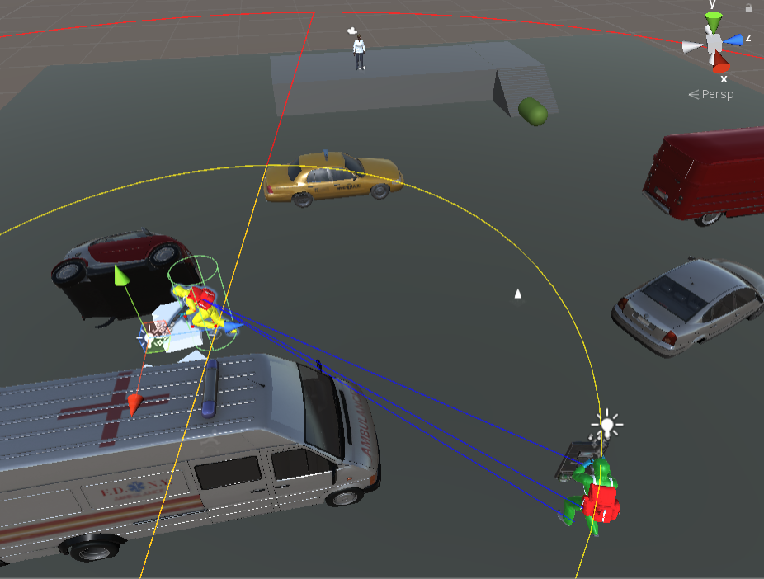
Dynamic cover-based system
Developing dynamic cover-based system
AI agent throws a ray cast to detect the enemy;
A second ray cast has been implemented to detect a Shieldman colleague to be used ad a cover location while approaching the target;
Further development to be carried out;

Slide 23
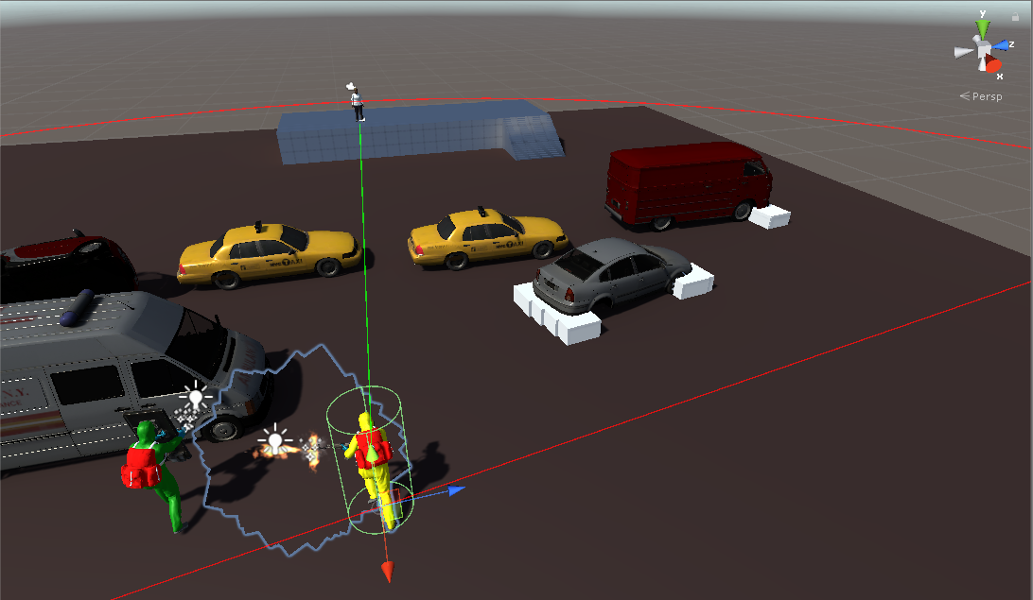
Low number of cover locations generated, quite accurate but only on the right hand side

Slide 24
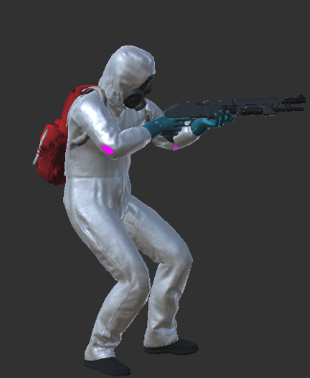
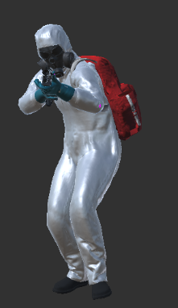
Designed for medium to short range combat due to the nature of the weapon (shotgun)
Needs cover locations nearer to target
Risks exposure if he/she approaches as no he/she has no protection.

Slide 25
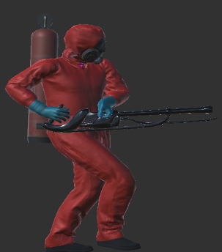
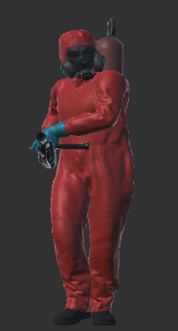
Designed for short range combat due to the nature of the weapon (Flamethrower)
Does not use cover locations
Slow moving due to weight of weapon
Risks exposure if he/she approaches as no he/she has no protection.

Slide 26

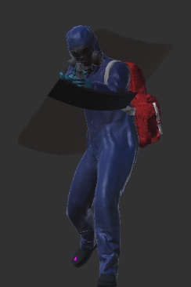
Designed for flexible range combat due to the nature of the weapon (pistol) and shield.
Flexible, fast moving.
Has a shield so which can retract and expand.

Slide 27
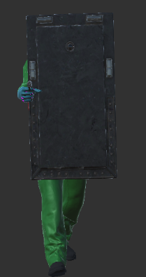
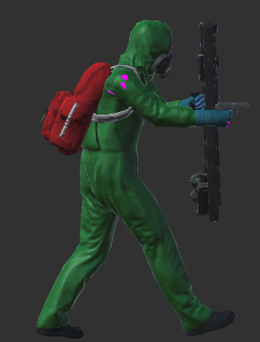
Designed for short range combat due to the nature of the weapon (Pistol and Shield)
Used to get in close range
Field of view will be used to generate cover positions for colleagues in close proximity to target due to his/her freedom of movement

Slide 28
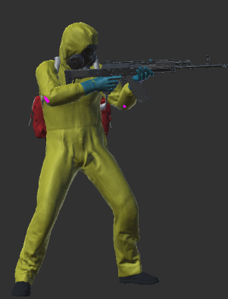
Designed for Longer range combat due to the nature of the weapon (shotgun)
Long range combat.
Fast moving
No natural protection
Needs cover locations
Generates cover locations within close proximity using Field Of view

Slide 29
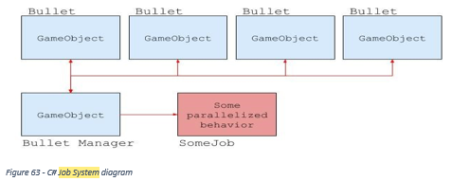
Unity Job System
Allows the development of multithreaded code;
Creates a correct interaction with the rest of the components;
Designed for working threads that do not overflow the capacity of the CPU;
Suitable for complex software where the result of an operation is dependent of the completion of another operation;
Detects every possible race condition and eliminates any error that may occur;
Released together with the Burst Compiler, as a feature of the Entity Component System;
The overhaul functionality is to work on copies of the data rather than the actual data.

Slide 30
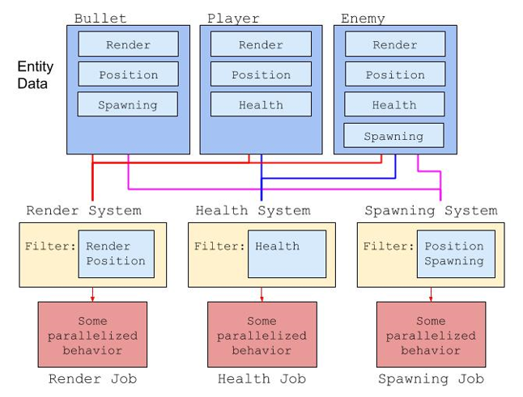
Entity Component System
Improved approach towards game design;
A code writing method focused on the behaviour and data problems in the game;
It replaces game objects in the game, with all their components;
Entities will contain all the necessary data;
Improves the default performance of the game;
An entity is used to control a collection of data that can be filtered for the collection by its components;
All the data is filtered in arrays and processed behind the scenes without the need for any reference types;
ECS takes a different approach splitting the game in three parts:
Entities – group together components;
Components – contain data, without any logic;
Systems – define component-based behaviour.

Slide 31
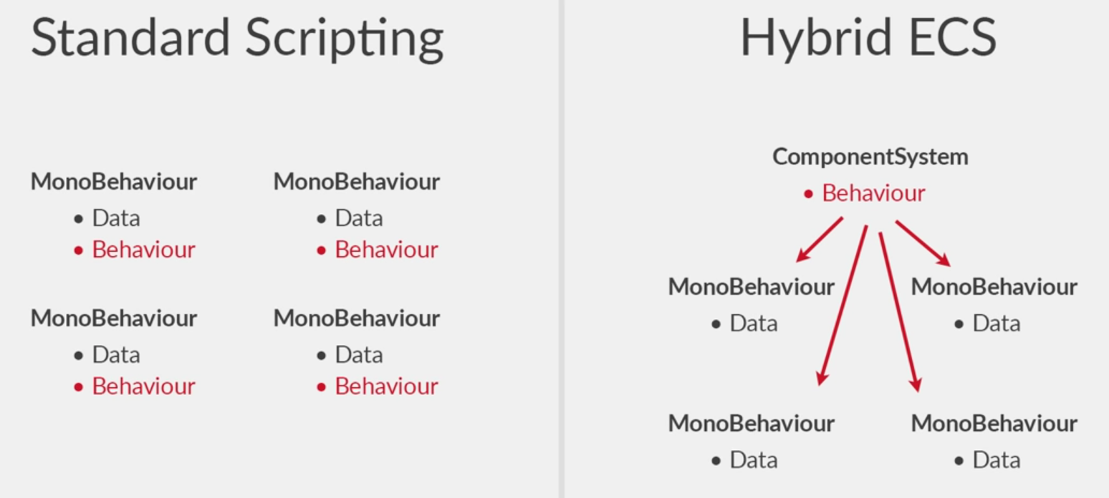
Hybrid ECS
The ECS approach is still in an experimental phase.
Hybrid ECS has been implemented as a transition from Standard Scripting to Pure ECS;
The full performance benefits of Pure ECS will not be unlocked by using Hybrid ECS;
A good way to start converting the scripts while still using MonoBehaviour components to store data;
In standard scripting, every object has a scrip that contains data to handle the behaviour of the object;
In Hybrid ECS there is a script which contains the data, but a component system is implemented to control the behavior of the object

Slide 32
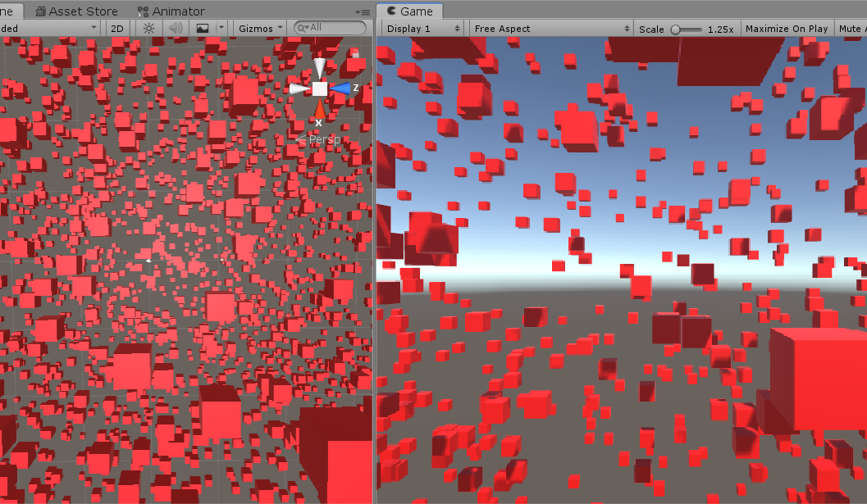
Unity Jobs vs Standard multithreading
A game scene is created to instantiate 3000 game objects;
The game object are mobile, traveling at the same speed, and instantiated in a designated area;
A Boolean value is assigned to the script, while true the script will benefit the capabilities of the Unity Job System;
The Unity Profiler will measure the scripting performance of Unity Jobs and standard multithreading.
Conclusions will be drawn based on scripting performance of both frameworks.

Slide 33
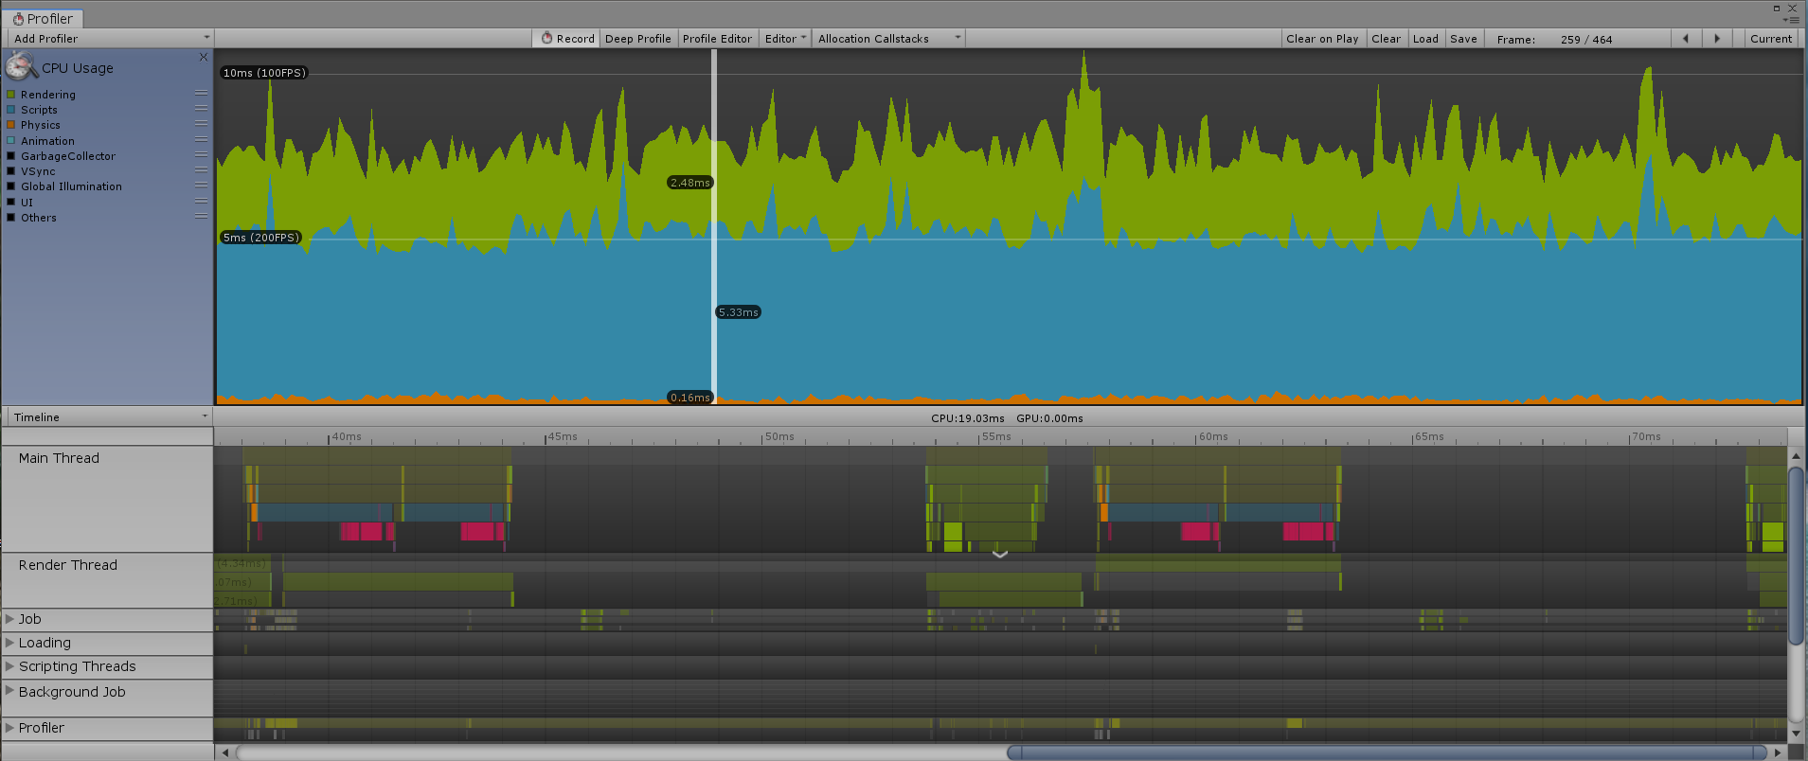
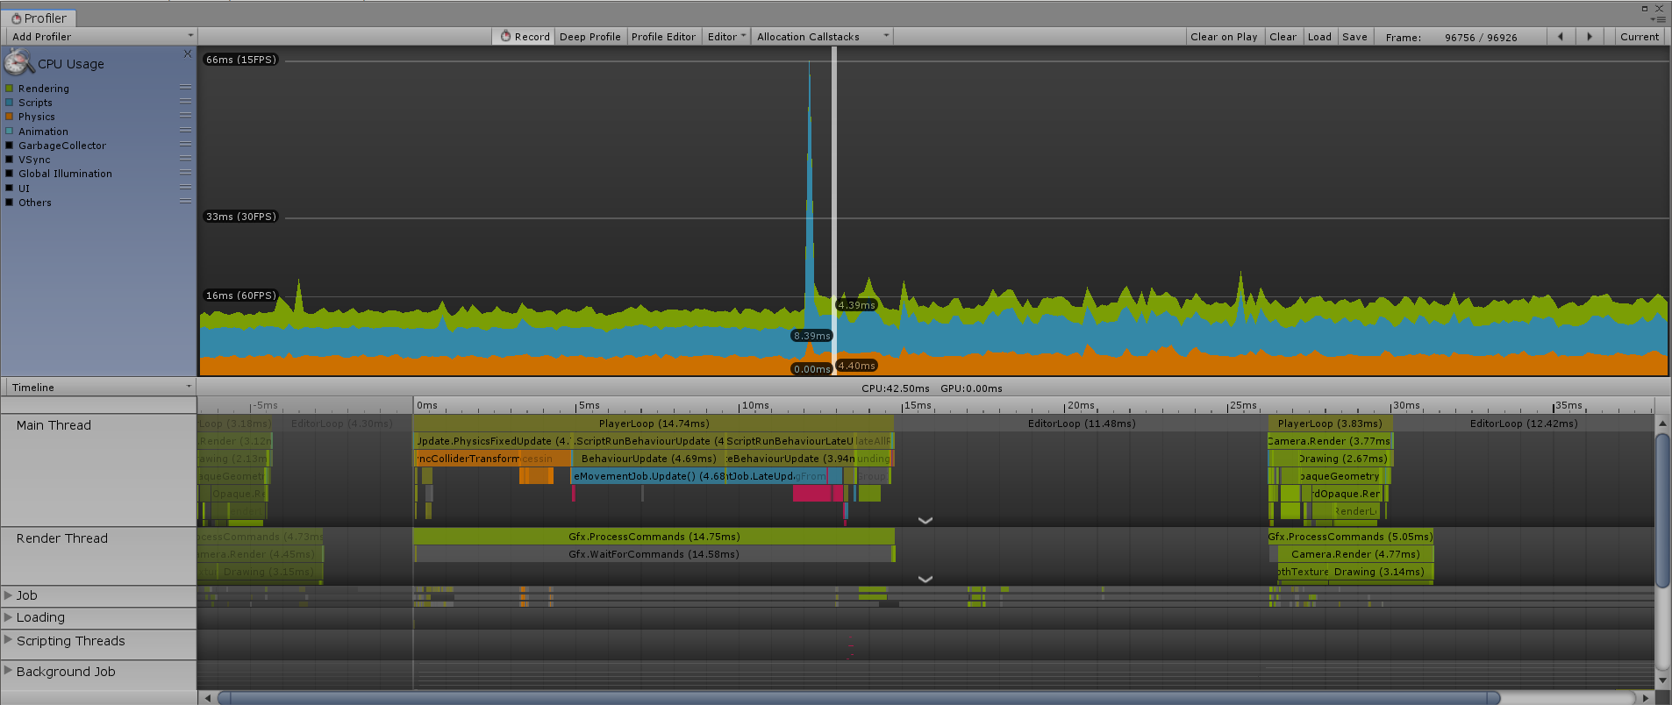
Unity Jobs vs Standard multithreading
Unity Jobs
While using Unity Jobs, a script completes in 5.33ms.
Standard multithreading
While using simple multithreading a script completes 8.39ms.

Slide 34
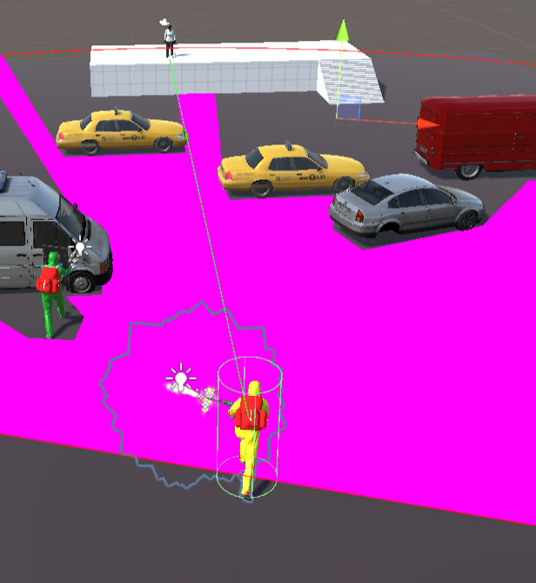
Individual sequence of instructions
The field of view of the AI is the only method not connected to a transform component;
Any other methods connected to a transform cannot be processed outside the main thread due to the design of the Unity engine;
No tools are in place to view a single thread;
The developer must rely on functionality, errors, profiler and console messages to establish the functionality of the process.
Three methods will be used to remove AI functionality from the main thread.

Slide 35
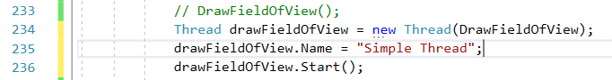
Individual sequence of instructions
Simple Threading
C# library is the base for the simple multithreading;
The process consists in creating a simple thread;
Add a process and start the thread.

Slide 36
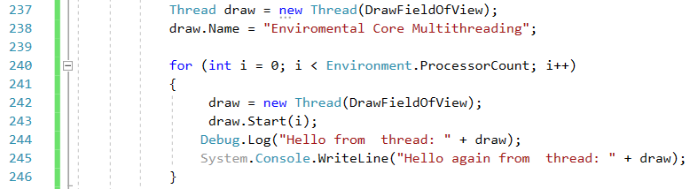
Individual sequence of instructions
Environmental Processor Count
The method iterates every available logic core, and via a for loop, a thread assigned with processing the AI agent field of view data will be assigned to a core.
The process involves simple threading.

Slide 37
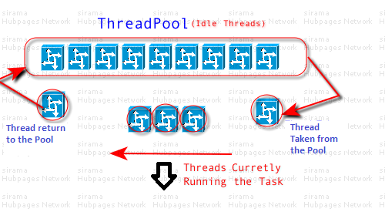
Individual sequence of instructions
Process Queue Threading
A general solution in multithreading using queue operations form .NET framework thread pooling mechanism;
The process is suitable for scaling and for long running thread pool operation.
Allows the users to specify the operations based on items and schedule operations using adjustable thread pools.

Slide 38
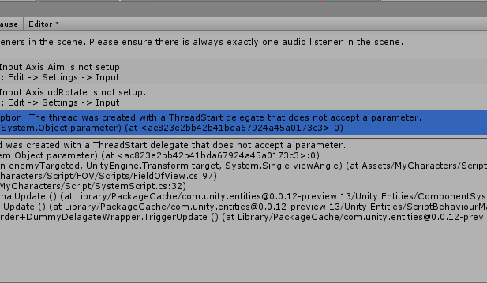
Individual sequence of instructions
Results
From the point of view of the developer all three multithreading attempts are functional;
Due to the restrictions imposed by the design of the Unity game engine in regards with transform components, the AI agent field of view represented the only possibility of having a process in the development of the game manually attached to an individual thread;
Due to script complexity, in developing the field of view of the AI agent, functionality has not been obtained while attempting to develop individual threads.

Slide 39
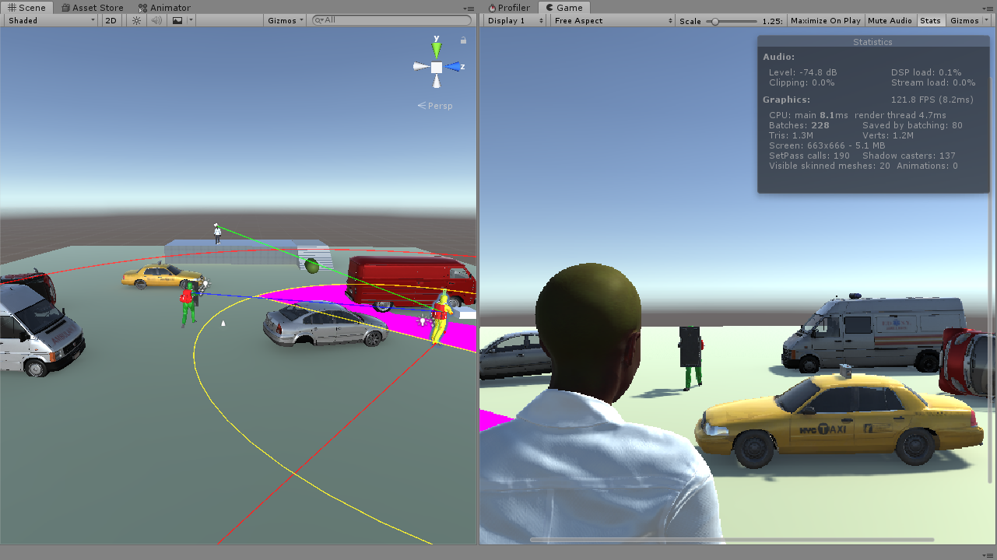
Overhaul Project Results
Every alteration implemented in the system, during the development project has brought significant performance improvements;
The overhaul rendering process of the system from 42FPS, in developer view mode, to 121FPS average rendering speed;
Based on the current rendering performance, the functionality of the system has overpassed the basic performances of modest games, good quality games and the game scene is suitable to be transformed to be rendered by VR devices.
Improvements are necessary;
Prototype stage.

Slide 40
Future Development
The device used in the development of the project will be taken apart and downgraded to the initial specification, where the measurement recorded has been approximately 35FPS;
A VR scene is proposed to be built for the current game scene, textures, graphics and terrains will complete to enhance the VR experience;
Further development will be conducted to complete the unique dynamic cover-based system feature designed for Patient Zero and, with the official ECS release, a transition from Hybrid ECS framework to Pure ECS.

